Slide 1

CAR HACKING 101

Slide 2

BEFORE WE BEGIN
Automobile security is a vast field of study
Automobile security is still under research
Vehicle automation and smart vehicles need this as top priority
No special pre-requisites : linux is preferred

Slide 3

CAR 🚗 NETWORK
ECU : ELECTRONIC CONTROL UNITS
20 -100 DEPENDING UPON FEATURES
SEATBELT, POWER STEERING, ABS, DOOR LOCKS
INTERCONNECTED – COOPERATIVE INTERACTION
SOME COMMUNICATE TO OUTSIDE EG: GPS, INTERNET, WIFI HOTSPOT

Slide 4
ATTACK SCENARIO
FINAL TARGET : ECU
TELEMATICS : TAP ON PHONE CALLS
GPS : LIVE CAR TRACKING
FINAL TARGET : PHYSICAL BEHAVIOUR
COLLISION DETECTION SYSTEM
AIR BAG
ABS

Slide 5
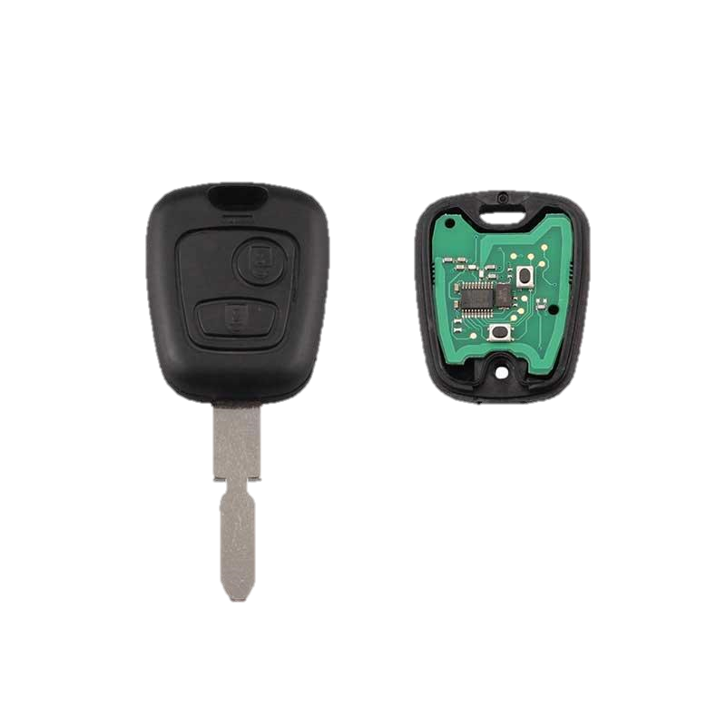
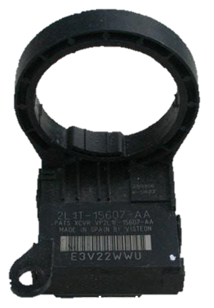
PASSIVE ANTI-THEFT SYSTEM [PATS]
CHIP IN IGNITION KEY 🔑
COMMUNICATES WITH SENSOR ON STEERING COLUMN
PREVENTS CLONED KEYS
KEY 🔑 TURNED ON → ON-BOARD COMPUTER EMITS RF SIGNAL → PICKED UP BY TRANSPONDER IN KEY → TRANSPONDER RETURN UNIQUE RF SIGNAL (CONFIRMATION)
PATS MODULE
434 Mhz [ID46] PCF7961

Slide 6
PASSIVE ANTI-THEFT SYSTEM [PATS]
ATTACK SCENARIO
RANGE : ~10 cm
DOS : PREVENT IGNITION
REMOTE ATTACK SURFACE IS VERY SMALL : ONLY DATA TRANSFERRED AND PROCESSED IS IDENTIFICATION CODE & RF SIGNAL.
RISK ANALYSIS : VERY LOW. NEED TO BE ABSOLUTE CLOSE TO SENSOR.
VEHICLE THEFT.

Slide 7

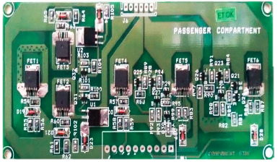
TYRE PRESSURE MONITORING SYSTEM [TPMS]
PRESSURE SENSOR IN EACH TYRE
RADIO SIGNAL COMMUNICATION
RECEIVING SENSOR WIRED INTO SMART JUNCTION BOX [SJB]
SJB : MAX1471A 315MHz/434MHz Low-Power, 3V/5V ASK/FSK Superheterodyne Receiver

Slide 8
TYRE PRESSURE MONITORING SYSTEM [TPMS]
ATTACK SCENARIO
RANGE : ~1 m
CAUSE VEHICLE TO MIMIC A TYRE PROBLEM
REMOTE ATTACK SURFACE IS SMALL : ONLY REPONSIBLE FOR ILLUMINATING A LIGHT IN INS CLUSTER.
RISK ANALYSIS : LOW.TPMS IS MOSTLY AN INDEPENDENT MODULE

Slide 9
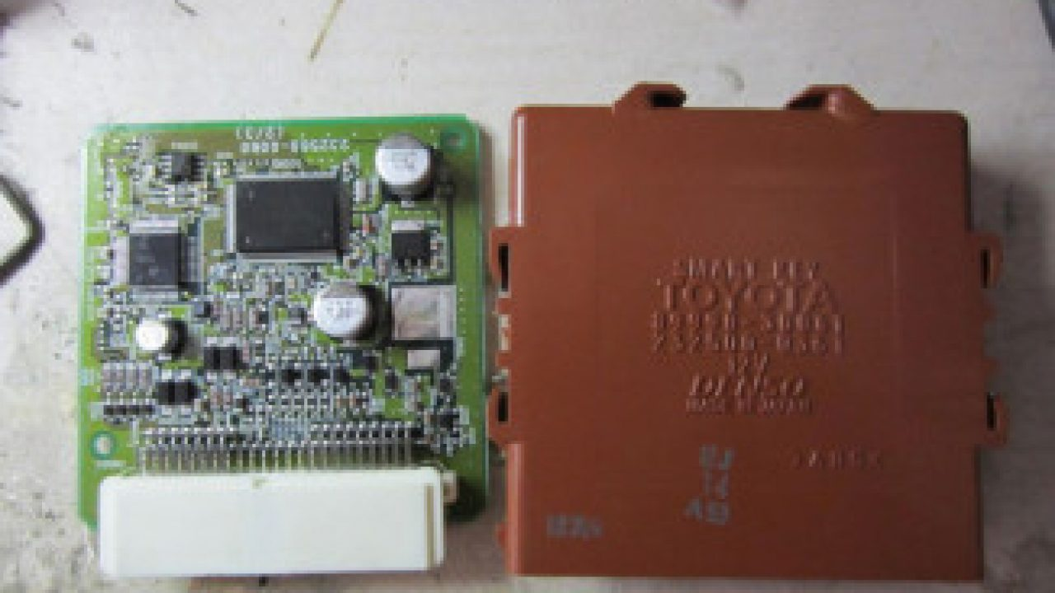
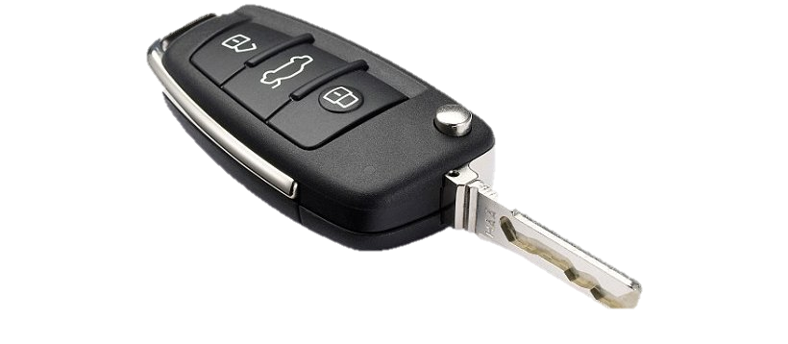
REMOTE KEY-LESS ENTRY [RKE]
KEY FOBS
SHORT RANGE RADIO TRANSMISSION
COMMUNICATES WITH ECU
KEY FOB TRANSMITS ENCRYPTED RADIO SIGNAL → SMART KEY ECU DECRYPTS DATA → IF DECRYPTED DATA MATCHES STORED DATA SEQUENCE → KEY FOB GETS SUCCESSFULLY AUTHENTICATED AND GETS CONNECTED TO CAN & LIN BUS
LOCK/ UNLOCK, IGNITION, POWER WINDOWS, alarm system.

Slide 10
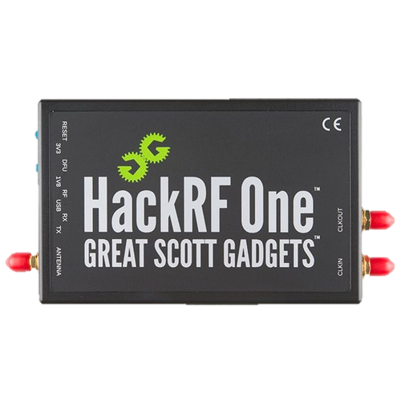
REMOTE KEY-LESS ENTRY [RKE]
ATTACK SCENARIO
RANGE : ~5-20 m
DOS : disabling key fob
TRANSMITTING FREQUENCY CAN BE PICKED UP & CLONED.
VULNERABILITY IN ECU FIRMWARE
UNLOCK/LOCK VEHICLE
HACK-RF ONE
RISK ANALYSIS : FAIR . RCE

Slide 11
Key fob hacking

Slide 12
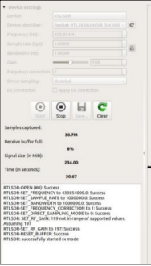
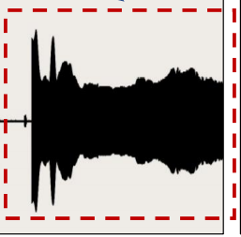
Key fob hacking
Majorly vehicles use : 433.xx mhz & 315.xx mhz
Frequency modulation used : phase shift keying [psk]
Gadgets required : hack-rf-one or
Rtl-sdr : signal receiver
Yard stick one : signal jammer via rfcat
Blade rf : signal transmitter
Urh : signal transmitter

Slide 13
BLUETOOTH [BLE]
INFOTAINMENT
CALL/ SMS/ NOTIFICATION
COMMUNICATES WITH ECU
PROCESSED BY ACCESSORY PROTOCOL INTERFACE MODULE [APIM]

Slide 14
BLUETOOTH [BLE]
ATTACK SCENARIO
RANGE : ~10 M
DOS : disabling BLUETOOTH CONNECTIVITY
MITM – INTERCEPT CALLS/ SMS
RISK ANALYSIS : HIGH . RCE
2 ATTACK SCENARIOS : UNPAIRED & PAIRED WITH KNOWN VULN.

Slide 15
RADIO DATA SYSTEM
AUDIO CONTROL MODULE [ACM]
AUDIO SIGNAL/ FM-AM
COMMUNICATES WITH ECU
PROCESSED BY ACCESSORY PROTOCOL INTERFACE MODULE [APIM]
RANGE : ~MILES
RISK ANALYSIS : LOW . SIGNALS ARE MOSTLY SIMPLY CONVERTED TO AUDIO OUTPUT AND DO NOT REPRESENT SIGNIFICANT DATA PARSING. LESS LIKELY TO CONTAIN EXPLOITABLE VULNERABILITIES.

Slide 16
TELEMATICS/ CELLULAR/ WiFi
GSM/ 3G/ 4G TO CONNECT TO CELLULAR DATA
WEATHER INFO
GPS
WIFI HOTSPOT
MAY NOT DIRECTLY COMMUNICATE CAN.
MICROPHONE.
WIFI HOTSPOT – OPEN PORTS SCAN USING NMAP
RISK : HIGH. WIDE ATTACK VECTORS
WEB BROWSER / APPLICATION EXPLOITS.

Slide 17
FILE SYSTEM & SERVICES
NAND FLASH
IPL : INITIAL PROGRAM LOADER – BOOTLOADER
IFS : System binaries & config files
Etfs : embedded transaction file system – R/W – DIRECTORY STRUCTURE
MMC : MULTIMEDIA CARD – MOUNTED @ /FS/MMC0/

Slide 18
# netstat -n | grep LISTEN
tcp 0 0 *.6010 *.* LISTEN
tcp 0 0 *.2011 *.* LISTEN
tcp 0 0 *.6020 *.* LISTEN
tcp 0 0 *.2021 *.* LISTEN
tcp 0 0 127.0.0.1.3128 *.* LISTEN
tcp 0 0 *.51500 *.* LISTEN
tcp 0 0 *.65200 *.* LISTEN
tcp 0 0 *.4400 *.* LISTEN
tcp 0 0 *.6667 *.* LISTEN

Slide 19
2011: NATP
2021: MontiorService. This service delivers debug/trace information from runtime system into file or over TCP/IP; offers additionally the possibility to send GCF message over TCP/IP to the SCP system
3128: 3proxy. This is a proxy service.
4400: HmiGateway
6010: Wicome
6020: SASService. This service realizes the server part of client-server based Speech API architecture
6667: D-BUS session bus
51500: 3proxy admin web server
65200: dev-mv2trace

Slide 20
COMMUNICATION PROTOCOLS

Slide 21
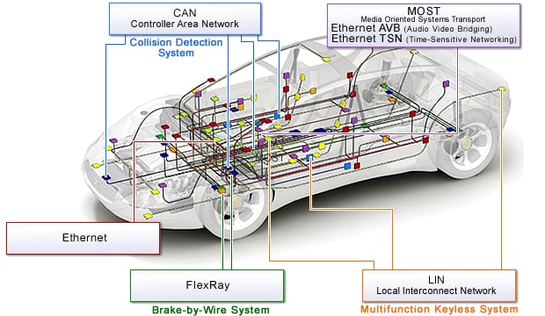
CONTROLLER AREA NETWORK [CAN] BUS
Message based protocol that allows microcontrollers and devices to communicate between hosts in a vehicular network
IMG Source : www.renesas.com

Slide 22
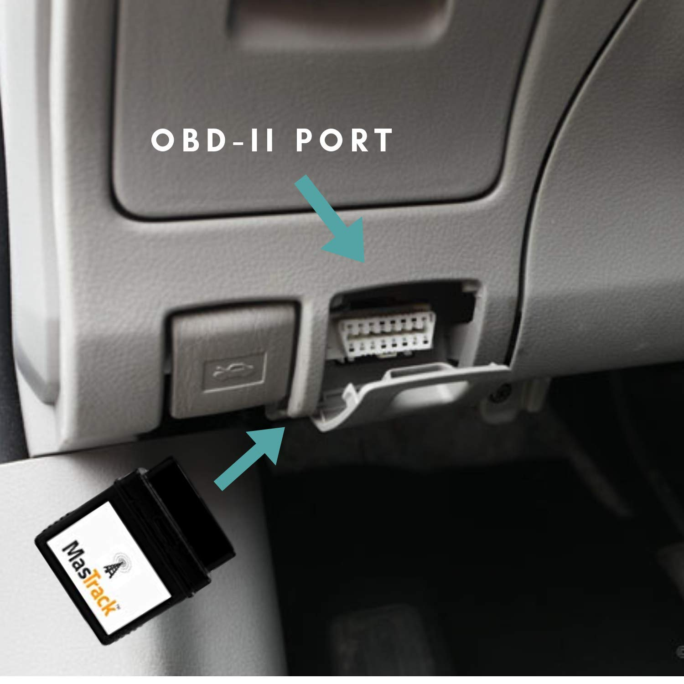
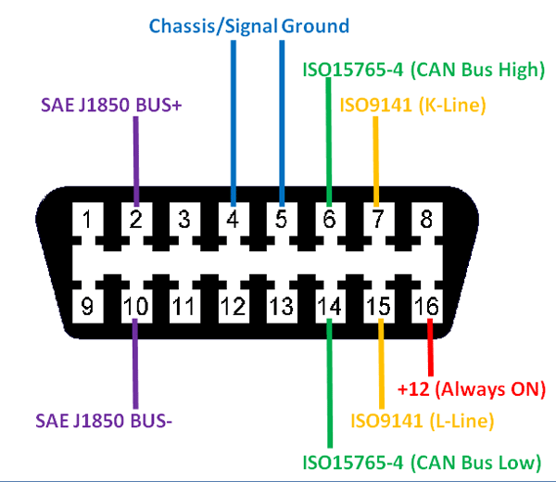
[CAN] BUS can be accessed via obd-ii [onboard diagnostic] port
Located near dashboard

Slide 23
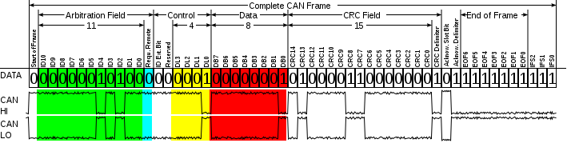
Field definition breakdown of can frame
IMG Source : https://en.wikipedia.org/wiki/CAN_bus

Slide 24
Field definition breakdown of can frame
FIELD NAME | LENGTH [bits] | PURPOSE
Start-of-Frame | 1 | Denotes the start of Frame Transmission
Identifier | 11 | Represents Message Priority
Remote Transmission Request [RTR] | 1 | Must be Dominant (0) for Data Frames & Recessive (1) for Remote Request Frames
Data Length Code [DLC] | 4 | Number of Bytes of Data (0-8 bytes)
Data Field | 0-64 (0-8 bytes) | Data to be Transmitted
Cyclic Redundancy Check [CRC] | 15 | Checks for faulty frames & Rearranging Data

Slide 25
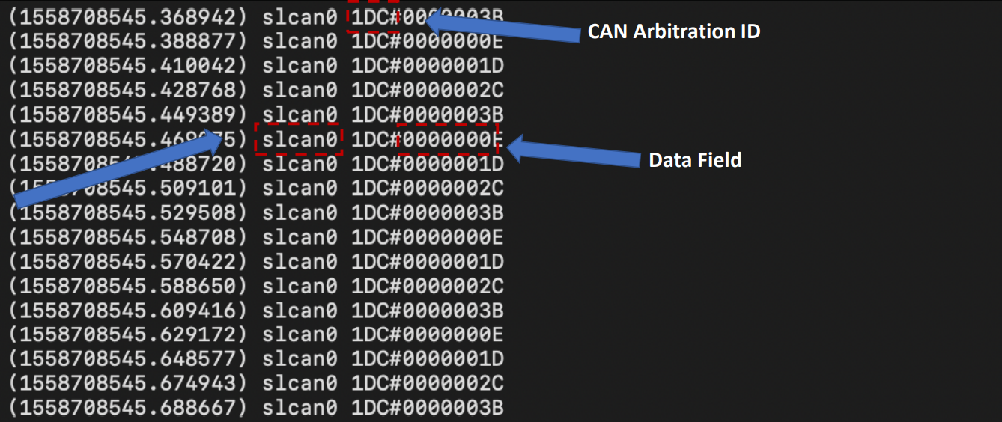
Actual can frame message
Interface
LIVE capture via Can Utils

Slide 26
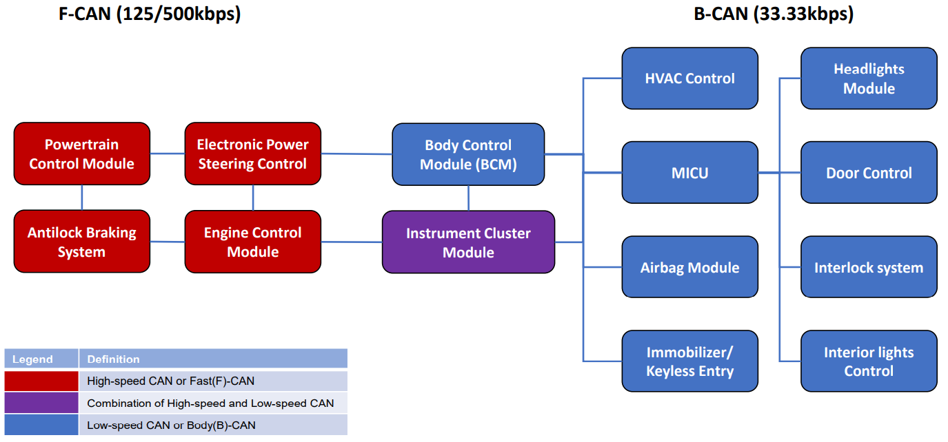
CAN bus is Broken into high-speed can [f-can] & low-speed can [b-can]
IMG Source : https://blog.trendmicro.com

Slide 27
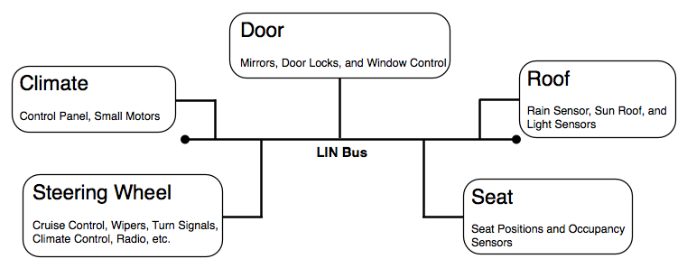
LOCAL INTERCONNECT NETWORK [LIN]
LAN protocol using single master→slaves
Relatively slow in-vehicle communication & network
KEYLESS SYSTEM/ air condition, seat movement
12v over single wire implementation – vehicle chassis as curr return path
The maximum command size is 8 bytes, which can be transmitted every 10 ms, but commands of 2 bytes or 4 bytes can be sent every 5 ms
IMG Source : cecas.clemson.edu

Slide 28
MEDIA ORIENTED SYSTEMS TRANSPORT [MOST]
INFOTAINEMENT SYSTEMS
Optical fibre implementation
Maximum data rate : 150 mbps
Network topology : point to point via ring / star topology
Uses all 7 layers of osi reference layer for data communication
Latest implementation of most standard – most150
Most 150 has 5 kinds of communication channels :
Control of ecu
Packet data [navigation]
Synchronous transmission of multiple audio streams
Synchronous video streaming
Ethernet for interacting with internet protocol applications

Slide 29
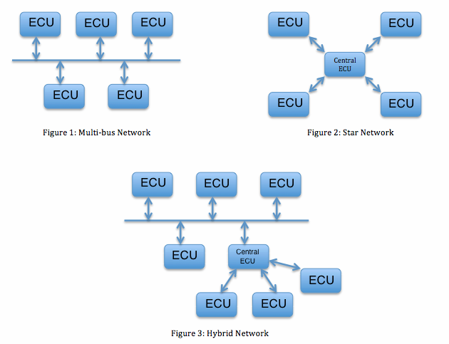
FLEXRAY BUS
HIGH SPEED BUS / fault tolerant systems
CRITICAL SYSTEMS – BRAKE BY WIRE / steer by wire
Layout : star / hybrid layout / multibus →
single & dual channel config
Costly
Maximum data rate : 10 mbps

Slide 30
ETHERNET
INTERCONNECTIVITY WITHIN VEHICLE
High data rates : 100mbps / gbps
Automotive communication bus of the future : replace can/ flexray/ most
Unshielded twisted pair cables in star/ line topology
CAN BUS FLEXIBLE DATA RATE [FD]
EXTENSION TO ORIGINAL CAN-BUS PROTOCOL
PROVIDE ACCURATE REAL-TIME DATA

Slide 31
ATTACKS AGAINST CAR INFOTAINMENT SYSTEMS

Slide 32
IVI – In Vehicle infotainment system
A combination of in-vehicle systems containing hardware & software.
Delivers information & entertainment to driver & co-passengers.
Usually isolated from vehicle safety critical components through gateway.
Ivi is becoming more important component with growing demand for smart vehicles.

Slide 33
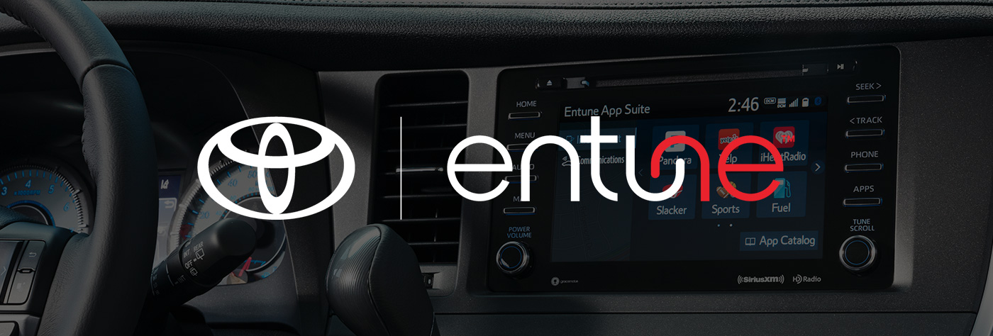
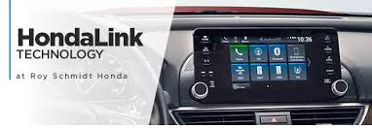


Ivi systems owned by automakers

Slide 34
key features of ivi
Multimedia play [audio/video]
Hands-free phone calls
Gps navigation
Traffic update
Social media notification
Voice assistant
More features = more vulnerable

Slide 35
Attack surfaces
Security without visibility – poor attack visibility is a major threat
One cannot protect what one cannot see
Attack Surfaces
USB Port
Applications
Multimedia Playback
Wireless Communication
External Diagnostic Interface

Slide 36
Usb port
Media playback
Firmware/ software updates
Attack vectors
Run Shell scripts / install unauthorised software
Usb to ethernet : use port scanning to detect vulnerable internal networking services / extra interface
Hack connected device/ leverage sms service etc
Dma attack – direct memory access against usb 3.x
Lets attackers compromise vulnerable system by plugging in a malicious hotplug device (usb 3.x) Eg:usb rubber ducky

Slide 37
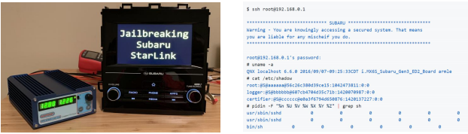
Firmware updates via usb
A security researcher could install malicious Subaru starlink head unit firmware via usb & gain persistent root code execution by exploiting cve-2018-18203.

Slide 38
Multimedia playback
Common entry point – cd/ usb/ aux/ Bluetooth/ airplay/ UPnP.
Specially prepared media-files can be used to tamper media engine services.
Specially coded digital media files made a cd into trojan
When played, the song could alter firmware using the vulnerability giving the attackers an entry point
These types of attacks could be sprea on file sharing networks without arousing suspicion.

Slide 39
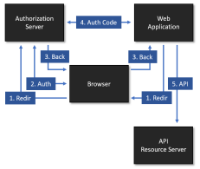
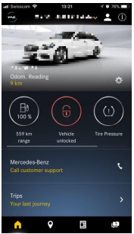
applications
Expand the functionality.
2 types : directly installed on ivi / installed on smartphone and can remotely connect to ivi
Cloud security – apps use cloud storage to store data
Vulnerability in connected vehicle app – mitm b/w app & server – cve-2018-18071-cwe-300

Slide 40
Wifi interfaces
Common weaknesses of wireless interfaces
Packet sniffing / jamming / mitm
Dsrc – dedicated short range communications
Invehicle internet
Vehicle-2-everything (v2x)

Slide 41

Vulnerability - carsblues
Found by privacy4cars
Exploit ivi systems via Bluetooth
Attacker can access stored contacts, call logs📞, text logs without owner being aware and without owners device being connected from cached memory

Slide 42
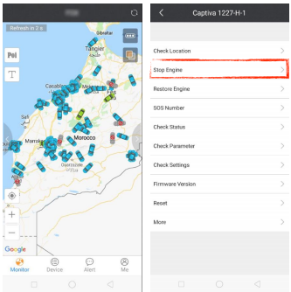
Vulnerability – gps apps
Default user account password found in gps tracker apps like protracker & itrack by reverse engineering
Breaking into these accounts allowed attackers to monitor vehicle locations and also allowed turning off engines of vehicles running slower than 12 mils/hr.

Slide 43
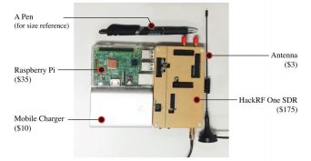
GPS SPOOFING
An attacker can send sat-nav-guided vehicle into oncoming traffic like one way roads by gps spoofing.
Raspberry pi & hack rf one

Slide 44
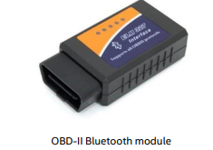
External obd module
On-board-diagnostic : vehicle’s self built in diagnostic
Initial physical access → Bluetooth via smartphone → error code diagnostics

Slide 45
Possible mitigations

Slide 46
For usb ports
Check file system of usb stick and allow only supported file systems to mount
Enhance security permission with read-only, no-dev, no-exec options
For updates
Always sign/encrypt update packages
Allow secure boot for integrity validation
Secure key storage
Rescue mode to fall back in case of update failure

Slide 47
For onboard applications
Allow to be installed from official sources
Divide different security domains for application management and apply strict access model
Isolate high-risk applications into containers/ sandboxing
For remotely connected applications
Secure connections with backend cloud service
Improved authentication mechanism to prevent mitm
Weak password detection

Slide 48
For wireless communication
All wireless protocols need to be properly configured
All unused Bluetooth profiles should be disabled
Alert about invalid attempts
For gps spoofing
Saasm – selective availability anti-spoofing module - costly
Use receivers that can track multiple gnss signals (gps/ glonass/ galileo/ beidou) simultaneously

Slide 49
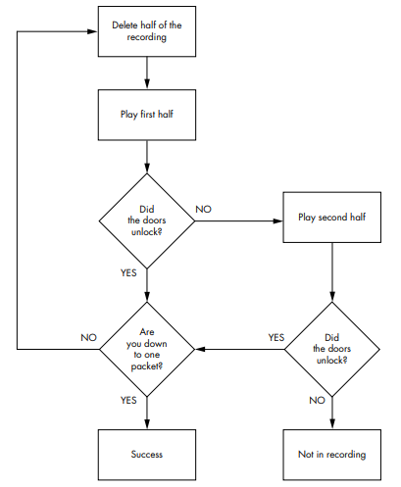
Can packet analysis
divide the CAN frames into two half and
perform the replay on each of them
capture the CAN frames using candump and use
wc utility to count the number of CAN frames
use split to divide the log into two half equally
use the canplayer to replay these CAN frame independently

